Slide 1
Local Industrial Strategies
The programme so far
Beatrice Andrews, Head of Local Industrial Strategies, Cities & Local Growth Unit

Slide 2
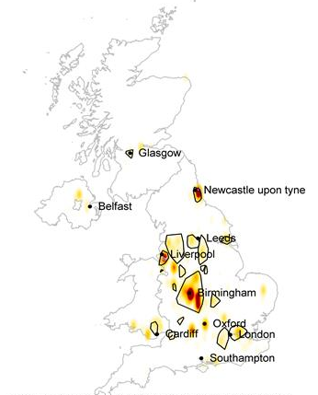
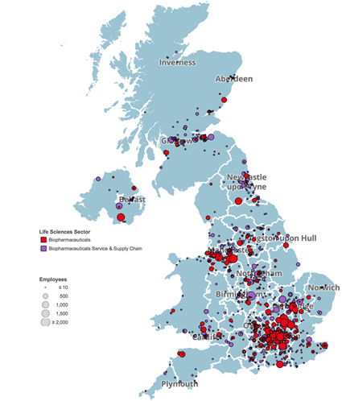
Harnessing the potential of place
The UK has world-class clusters across the country:
Automotive clusters in West Midlands, North East and North West
Clusters of life science expertise outside London and the South East.
Russell Group universities located in the major cities.
Notes:
Growth does not happen in the abstract, it happens in places.
There are clear strengths across the country, and clusters of industry and expertise that will generate growth for their region and for the UK.
We need to find a way to build on this growth and support our key industries.

Slide 3
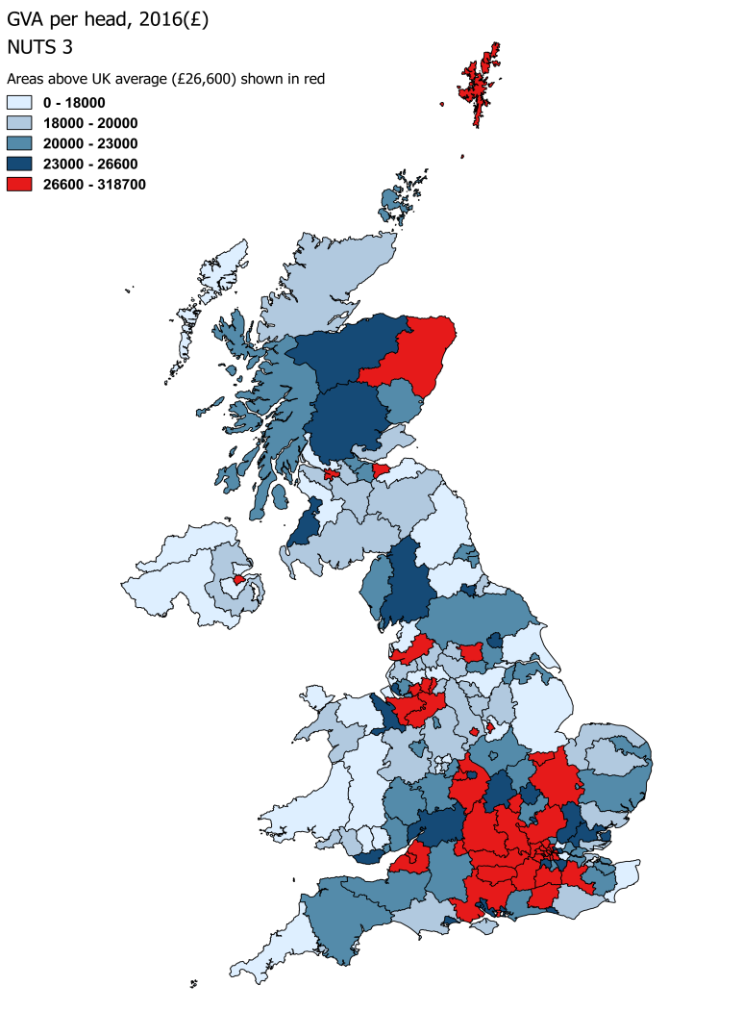
Creating prosperous communities everywhere
There is some way to go. Our core cities lag behind our main European competitors:
Notes:
Despite areas of excellence, many places are not realising their full potential.
Outside of London and the South-East, our regions and core cities lag-behind our main European competitors.
This affects people in their pay, their work opportunities and their life chances.

Slide 4
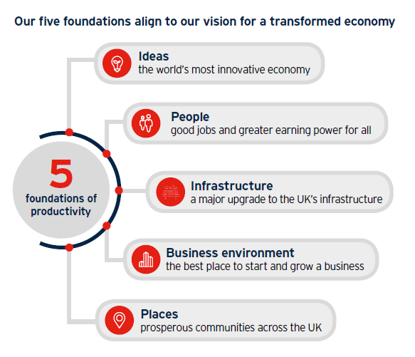
Setting a framework for growth
£1.6bn
for a Stronger Towns Fund
£42m
for a Transforming Cities Fund to improve intra-city transport
to fund innovation through the Strength in Places Fund
£235m
375,000
businesses supported by Growth Hubs
£675m
for a Future High Streets Fund
Notes:
The Industrial Strategy provides a national policy framework against which major public and private investments can be made with confidence.
Through addressing the foundations of productivity, it addresses the fundamentals of a successful economy.
We are investing to create prosperous communities throughout the UK, and Local Industrial Strategies are central to supporting places across the country.

Slide 5
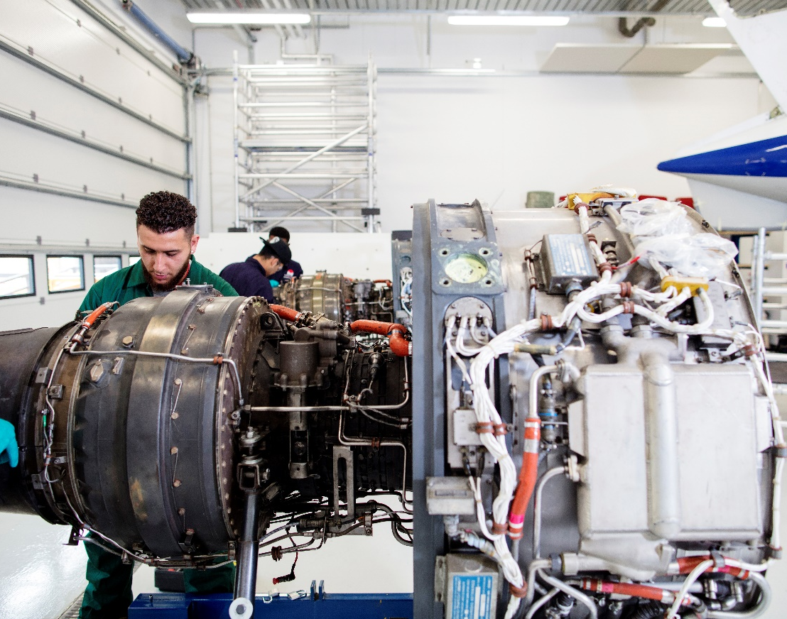
Local Industrial Strategies
“We will work in partnership with places to develop ambitious Local Industrial Strategies, which will be developed locally and agreed with the government.” – Industrial Strategy White Paper
All places developing their own Local Industrial Strategies
Led by Local Enterprise Partnerships and Mayoral Combined Authorities
Ensuring everyone, wherever they live can contribute to and benefit from economic prosperity
Notes:
Local Industrial Strategies will build on this approach.

Slide 6
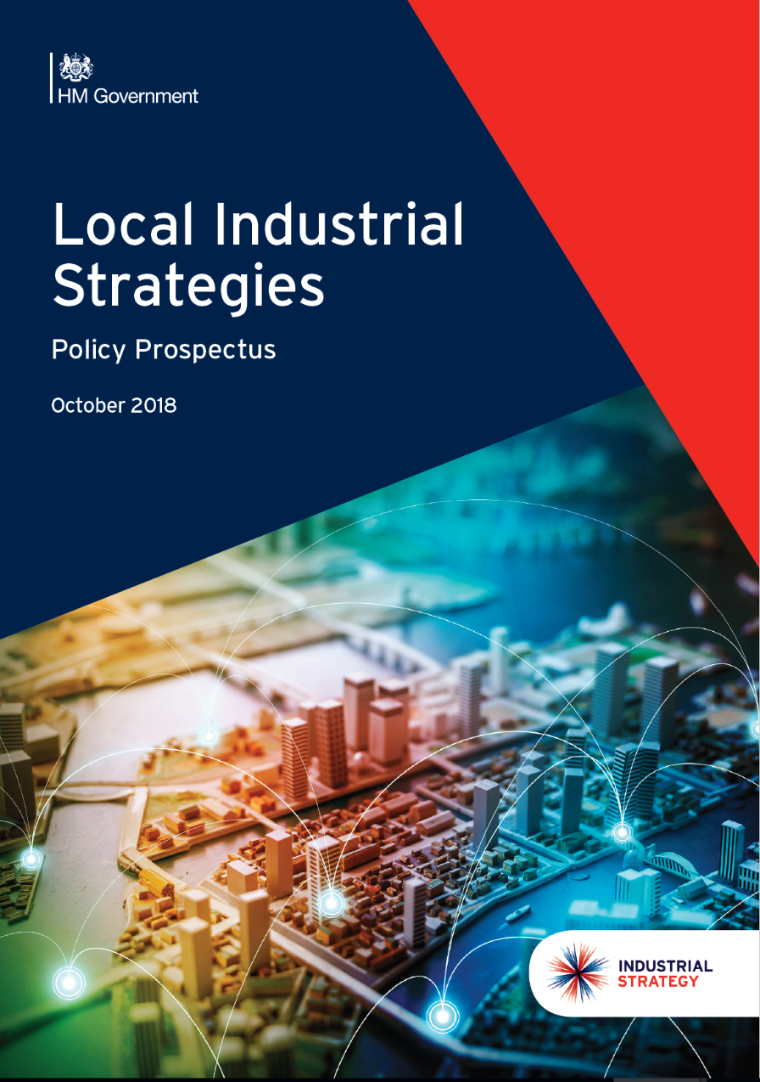
Local Industrial Strategies
Jointly owned: led by MCAs and LEPs, working with local businesses, universities and colleges, civil society
Building on local strengths and prioritising economic opportunities
Setting the strategic direction for future funding - including UK Shared Prosperity Fund.
Notes:
Local Industrial Strategies will build on this approach.

Slide 7
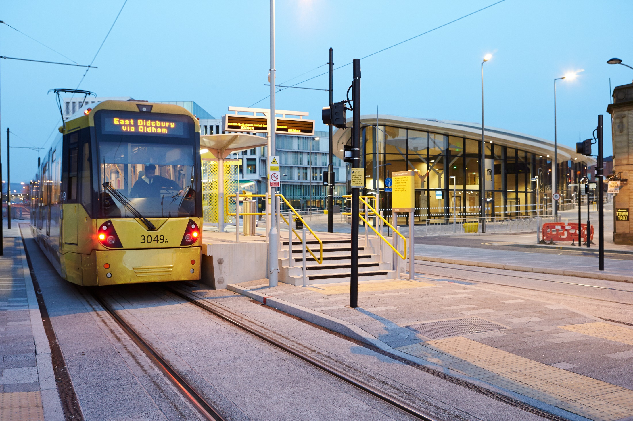
Developing a Local Industrial Strategy
EVIDENCE BASE
which is robust and open
FOCUS
on local strength and weaknesses
COLLABORATION
with public and private stakeholders
PRIORITISATION
of specific, achievable, long term ambitions
EVALUATION
clear plans for monitoring progress
Notes:
Establishing a strong evidence base
Analysing that evidence and identifying priorities
Local collaboration and consultation
Policy conversations with government
Drafting and securing agreement

Slide 8
Writing a Local Industrial Strategy
Evidence organised by foundation, with thorough analysis of the strengths and areas for improvement
Priorities emerging from analysis of evidence
Focus on productivity, but recognising balance with inclusive growth – prosperity that reaches all parts of the local economy
Understanding the grand challenges and which the place is in a position to tackle
Identifying what is distinctive about the place
Buy-in from local stakeholders that gives your strategy longevity
The basis for funding and investment decisions over the next 10-15 years
Notes:
LISs are not spending documents, but they are a gateway to local growth funding. Demonstrating that you have a robust, evidence-based understanding of your local economy. And that you know what your assets and your weaker areas are, is important

Slide 9
Support, guidance and networks
Dedicated area lead for each LEP and MCA – first port of call for places in developing LISs
Series of masterclasses and events focused on foundations and cross-cutting issues: recent themes include business environment, inclusive growth, ideas
Departments including DCMS planning regional events
Policy Prospectus (October 2018)
First two Local Industrial Strategies, expected May 2019

Slide 10
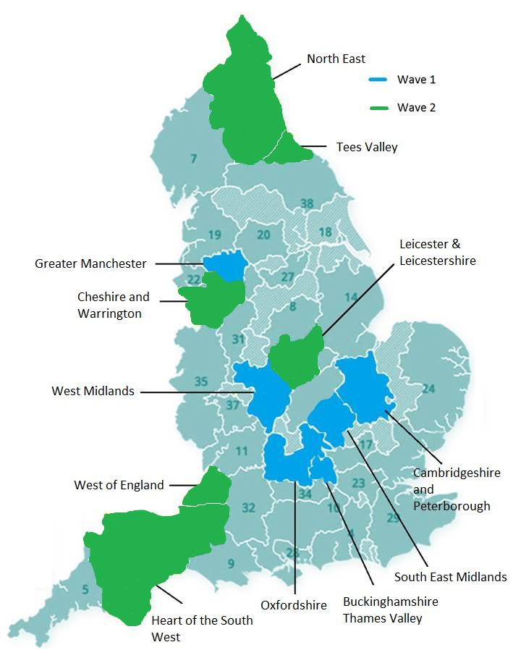
Publication of Local Industrial Strategies
Greater Manchester and West Midlands to publish first – May 2019
Four LEPs in the OxCam Arc to follow
Six ‘wave two areas including North East, Tees Valley, Heart of the South West
Others to watch include Greater Lincolnshire and Cumbria
Notes:
We have already been working intensively with Greater Manchester, West Midlands and partners across the Oxford – Milton Keynes – Cambridge corridor.
We have announced that Government will now work with all places to develop Local Industrial Strategies and will continue to work with the LEP Network to support places.

